Slide 1

BREAST CANCER DATA ANALYSIS
REVIEW-2
(Major Project)
2019MP122
Project Guide :
Ms. Shivangi Tyagi
Presented by :
SHOBHIT AGARWAL RA1511003030375
ANISH THAKUR RA1511003030317
SHAHVEZ MALIK RA1511003030327
PRIYAM KUMAR RA1511003030348

Slide 2
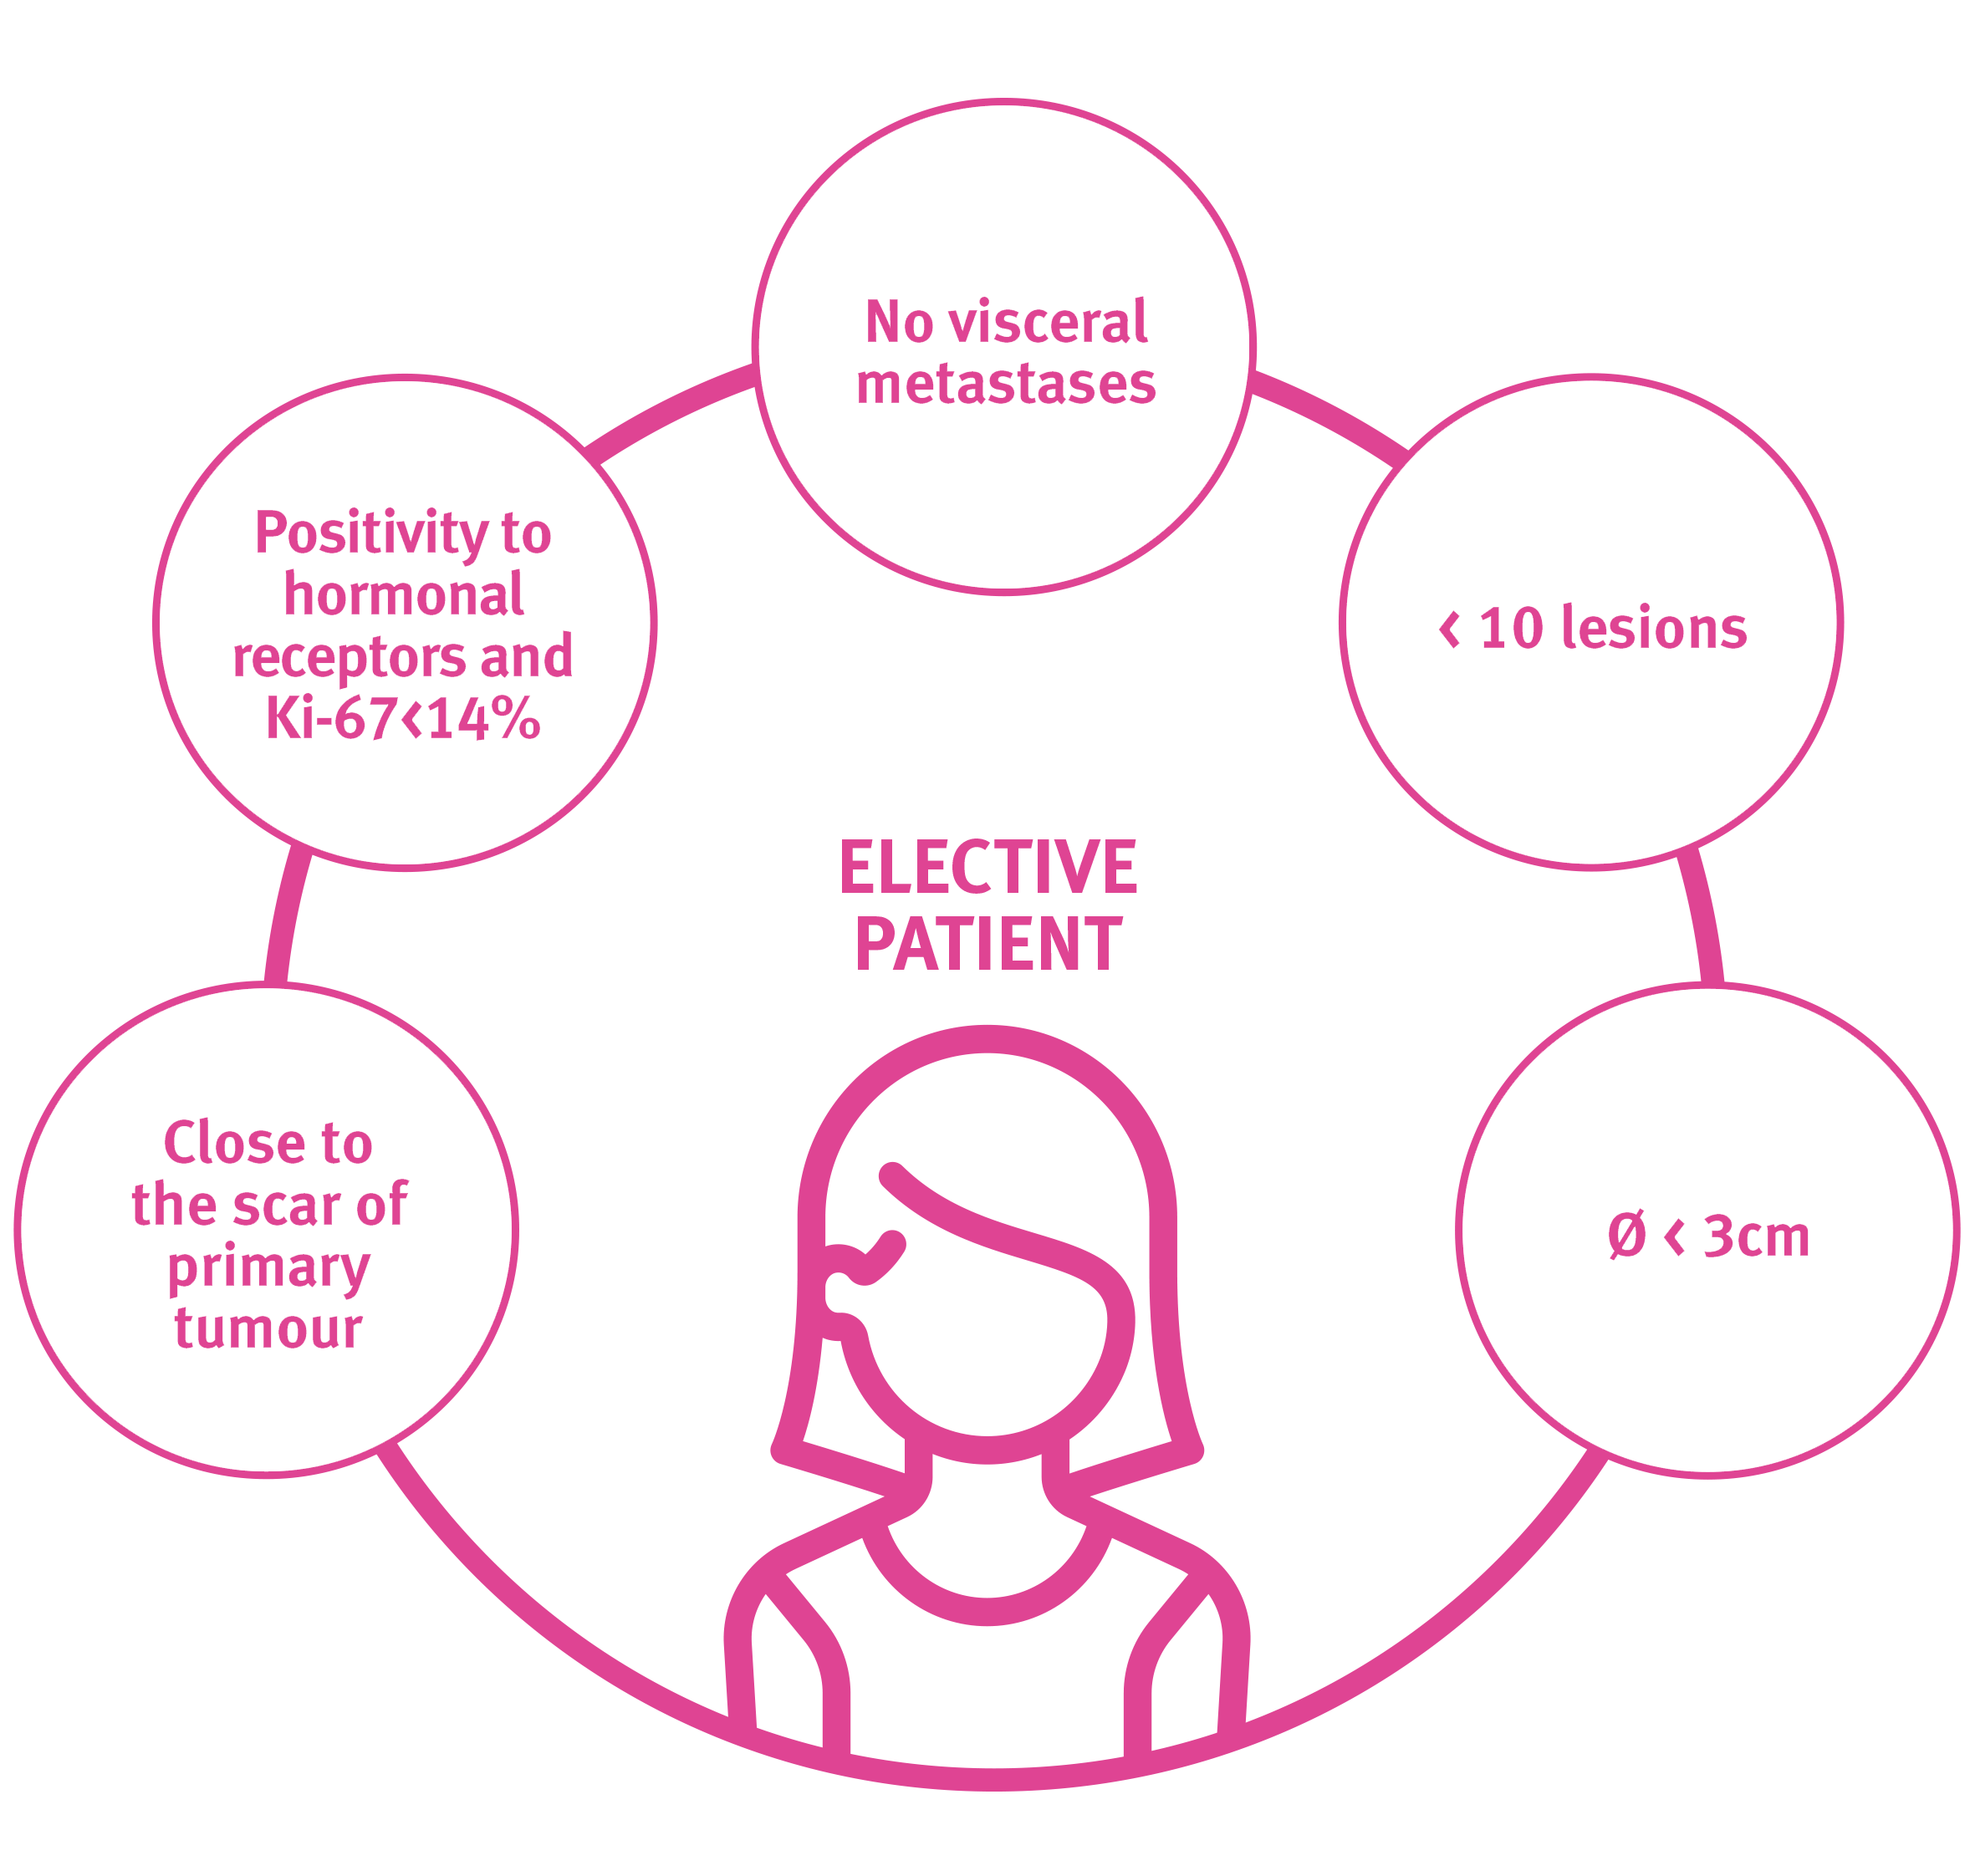

There is no shortage of enterprise data today. The digital era calls for analytics to be infused in every role, business process, decision and action. Biological research is conducted through the analysis of a particular disease. Applying classification algorithm to biological data with specific characteristics available in particular disease and established data mining based on data available on mentioned disease. Breast cancer is the most common malignant tumour for women. In the past twenty years, the cases of breast cancer continues to rise. The diagnosis and treatment of the breast cancer is compulsory. We intend to build a diagnostic model of breast cancer by using ensemble techniques. A feature extraction technique PCA (Principal Component Analysis) is applied on the data to select relevant features which leads to the breast cancer. The results of the experiments show that the accuracy of the diagnostic model improves a lot, and at the same time, relevant and important features for breast cancer diagnosis are chosen out. The diagnostic model for breast cancer built with good generalization.
ABSTRACT

Slide 3
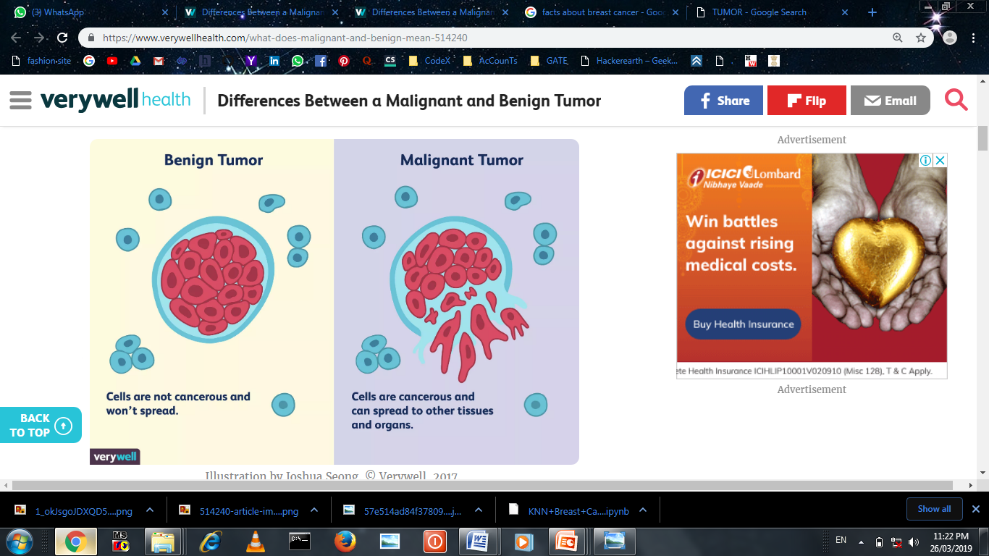
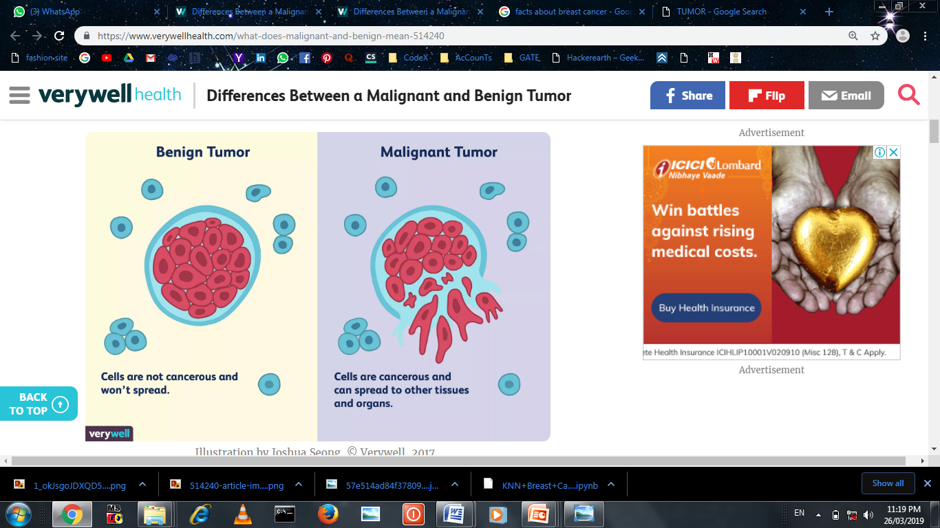
What is Tumor? A tumor is an abnormal lump or growth of cells. When the cells in the tumor are normal, it is benign. Something just went wrong, and they overgrew and produced a lump.
Characteristics of Benign Tumors:
Cells tend not to spread
Most grow slowly
Do not invade nearby tissue
Tend to have clear boundaries
Do not secrete hormones or other substances
May not require treatment if not health-
threatening
Unlikely to recur if removed or require further
treatment Such as radiation or chemotherapy
Characteristics of Malignant Tumors :
Cells can spread
Usually grow fairly rapidly
May recur after removal, sometimes in areas other the
original site
Can secrete substances that cause fatigue and weight
Loss (paraneoplastic syndrome)
May require aggressive treatment, including surgery,
radiation, chemotherapy, and immunotherapy
medications

Slide 4
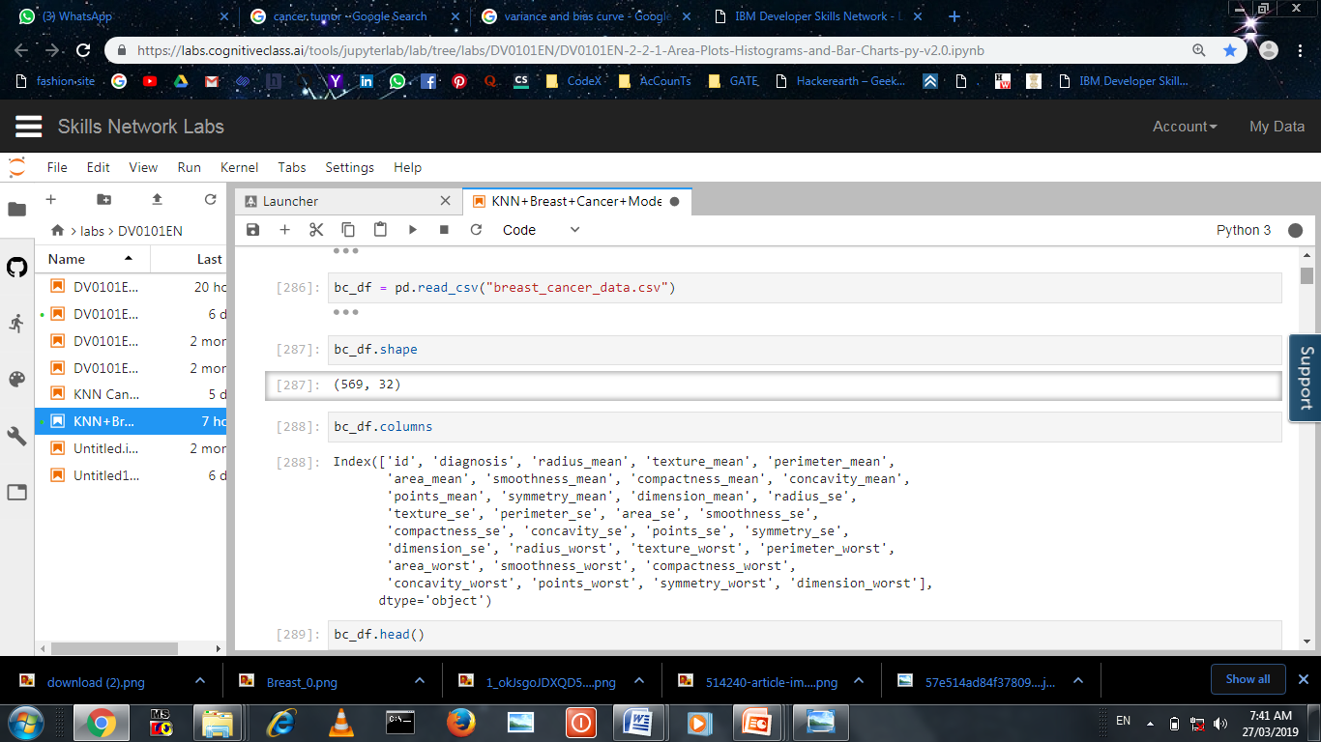
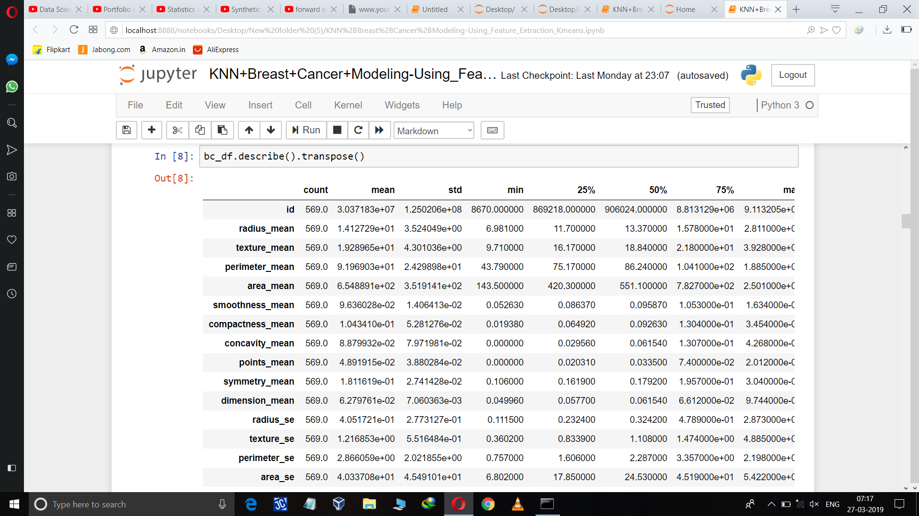
Importing the data and Performing EDA :
Describing continues variable from the data

Slide 5
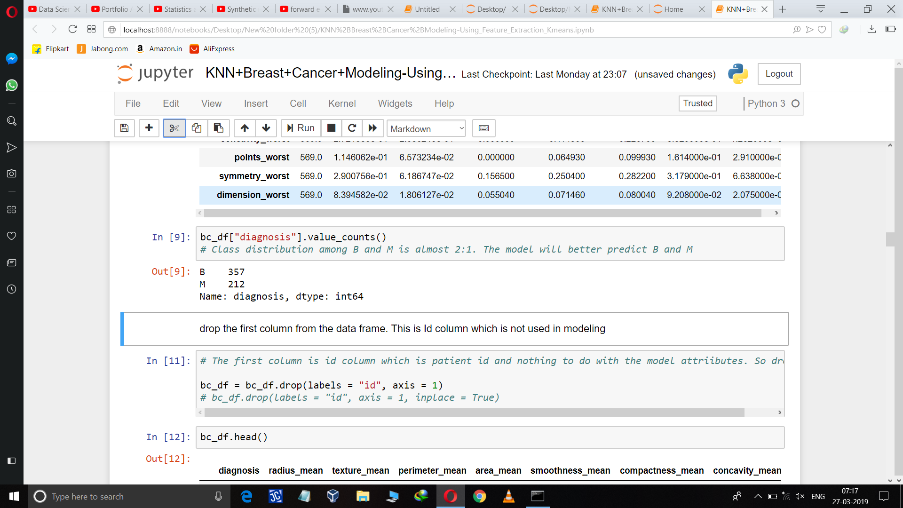
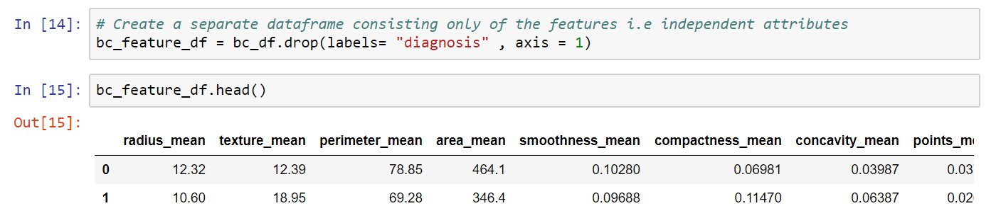
Number of Malignant and benign cases

Slide 6
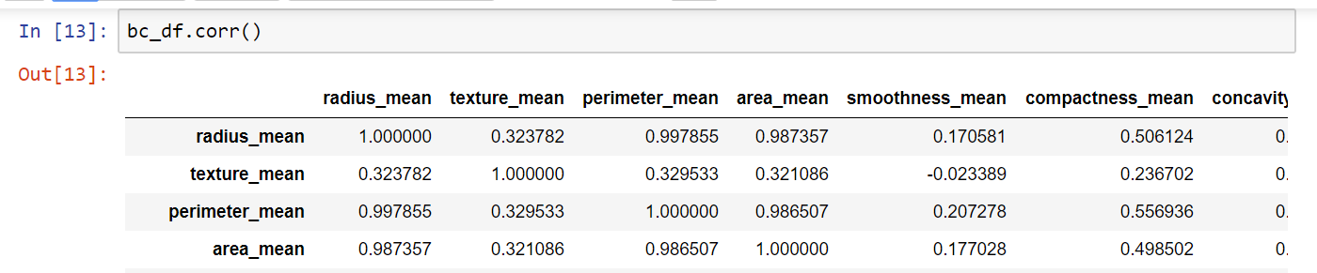
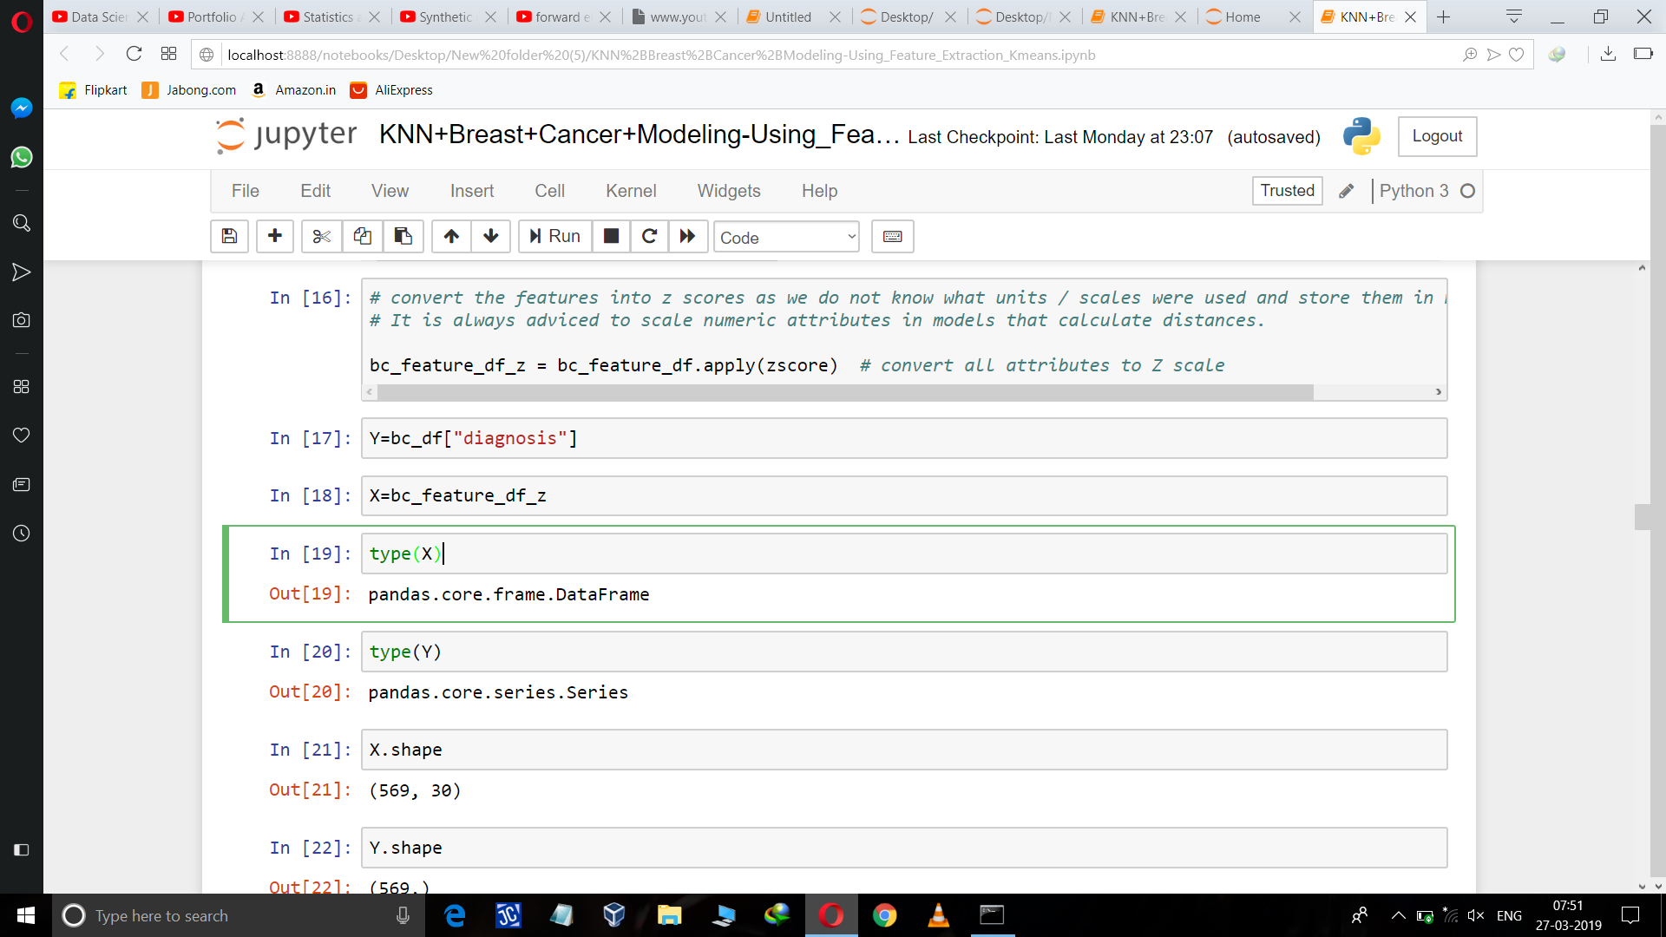
Correlation between dataset attributes :
Removing the outlier using Z-SCORE

Slide 7
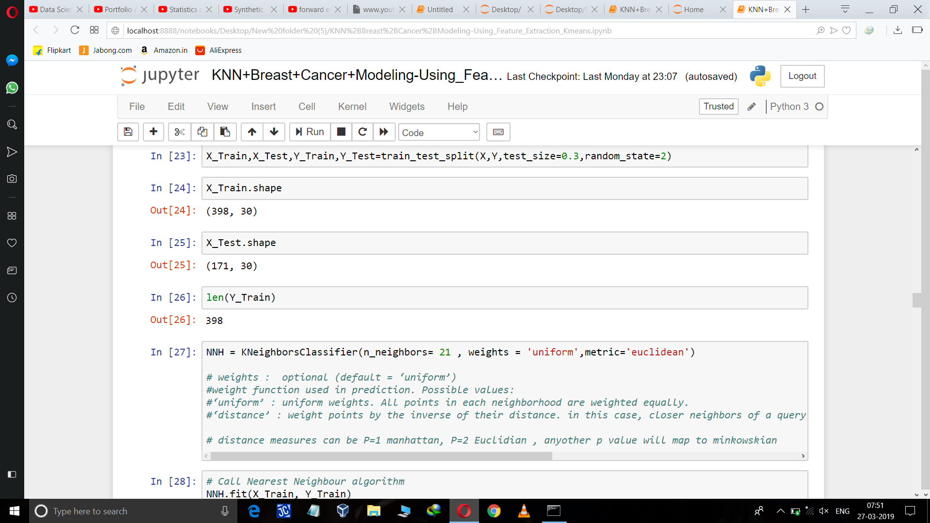
Splitting into Train and Test :
Applying KNN :

Slide 8
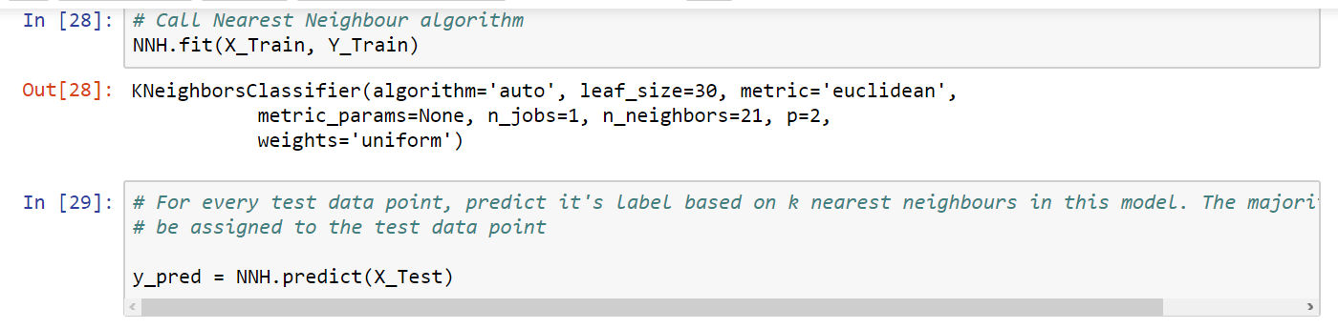
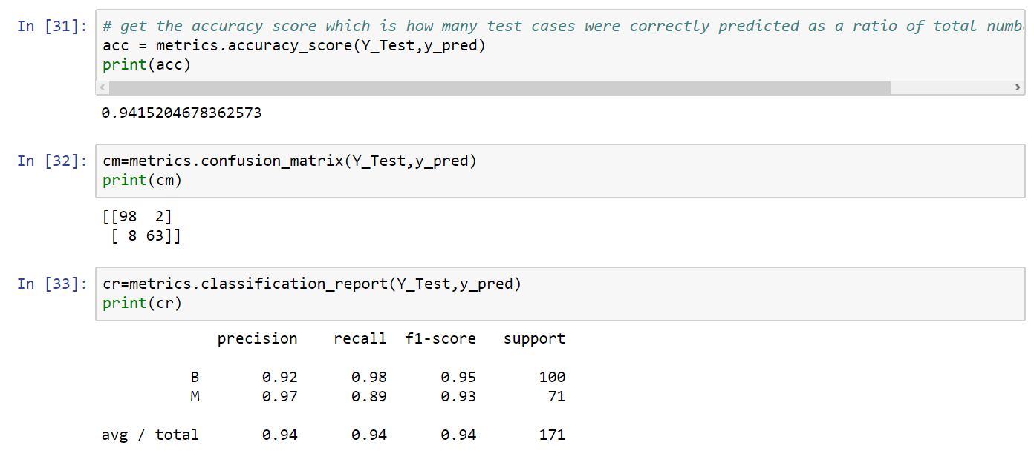
Checking Model Accuracy :

Slide 9
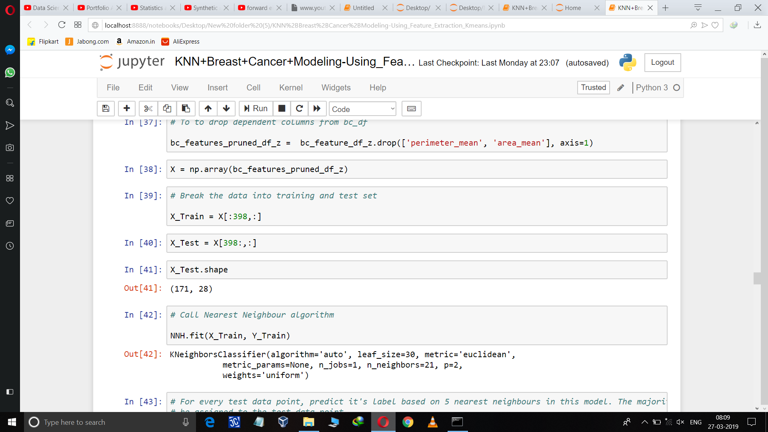
Removing Redundancy from dataset :
To Improve Performance by analyzing different attributes for distribution and correlation by using scatter matrix
As is evident from the scatter matrix, many dimensions have strong correlation .
Area and Perimeter are function of radius, so they will have strong correlation.
By providing both to model we introduce redundancy to the data.

Slide 10
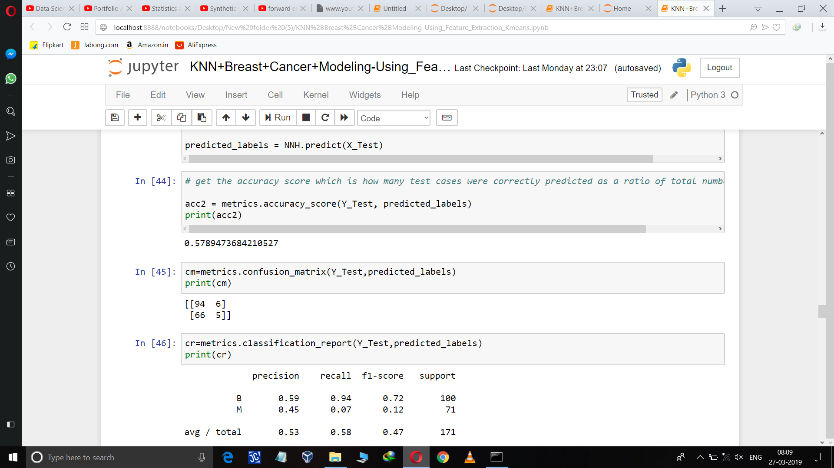
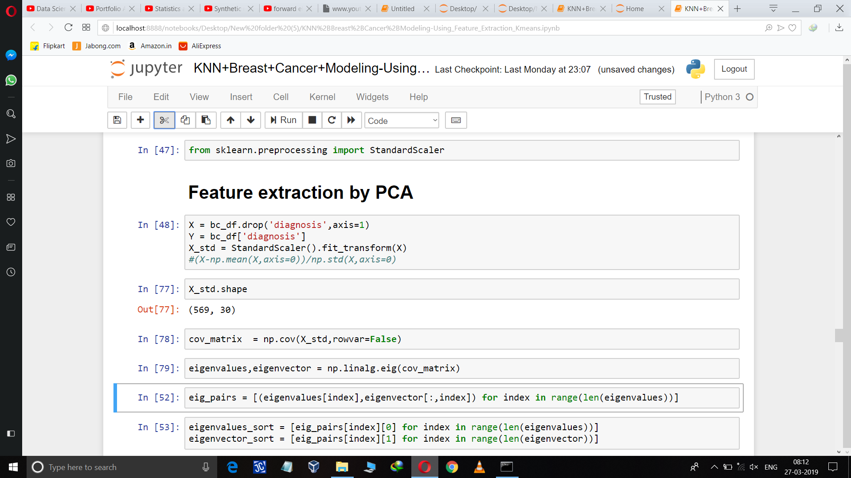
After dropping highly correlated data checking accuracy :
Accuracy of the model decreases as we drop the highly correlated data
So,using Feature Extraction Technique .

Slide 11
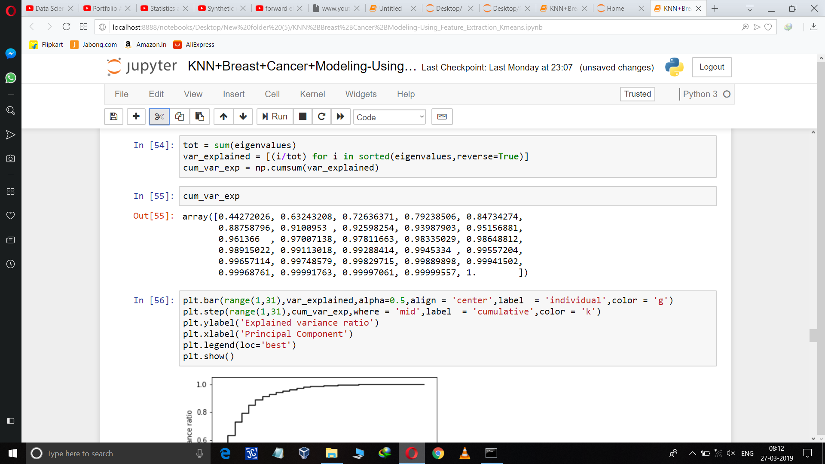
Cumulative Variance :

Slide 12
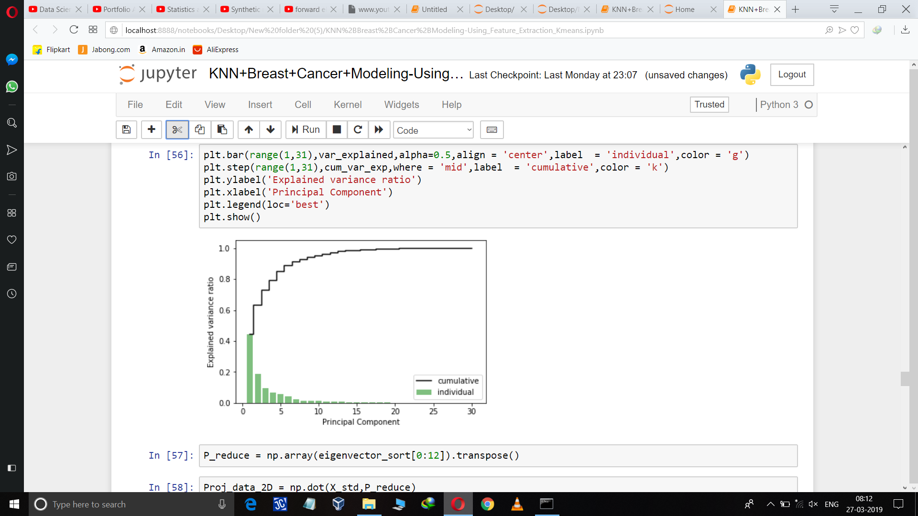
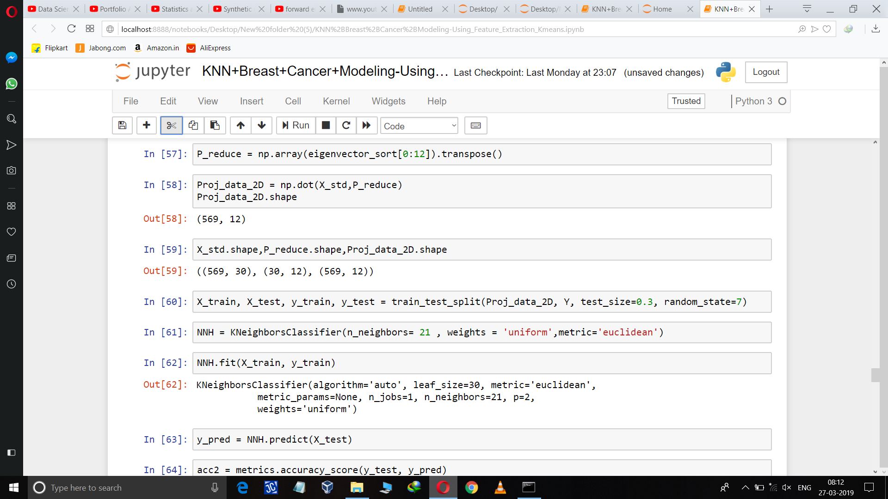
Cumulative Graph :

Slide 13
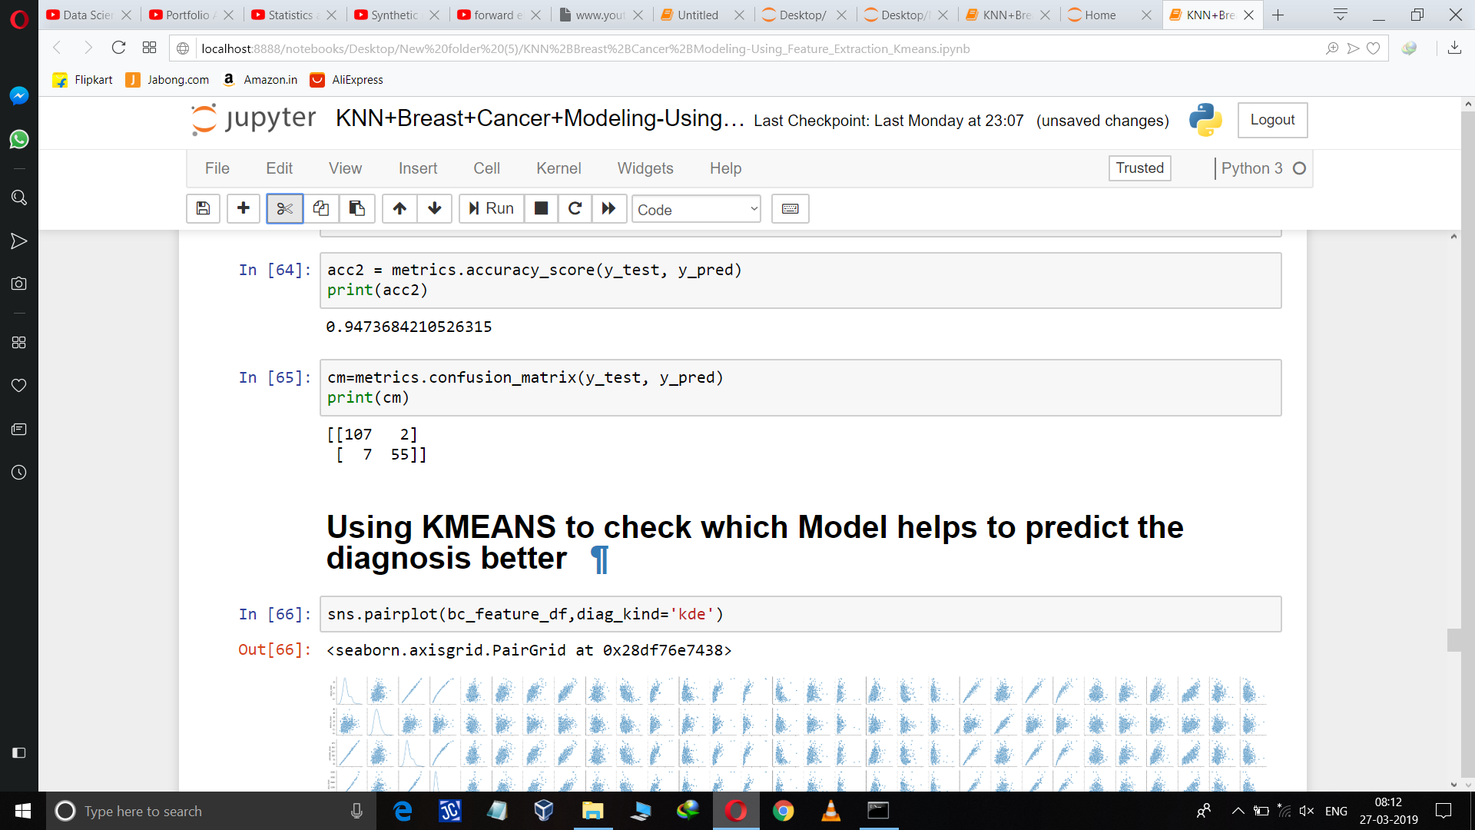
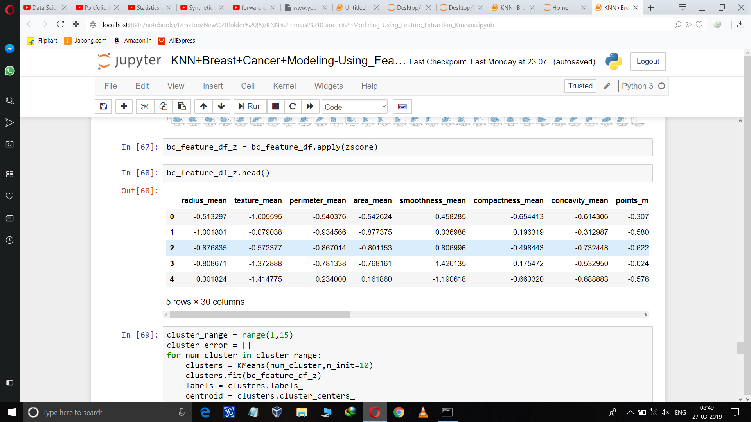
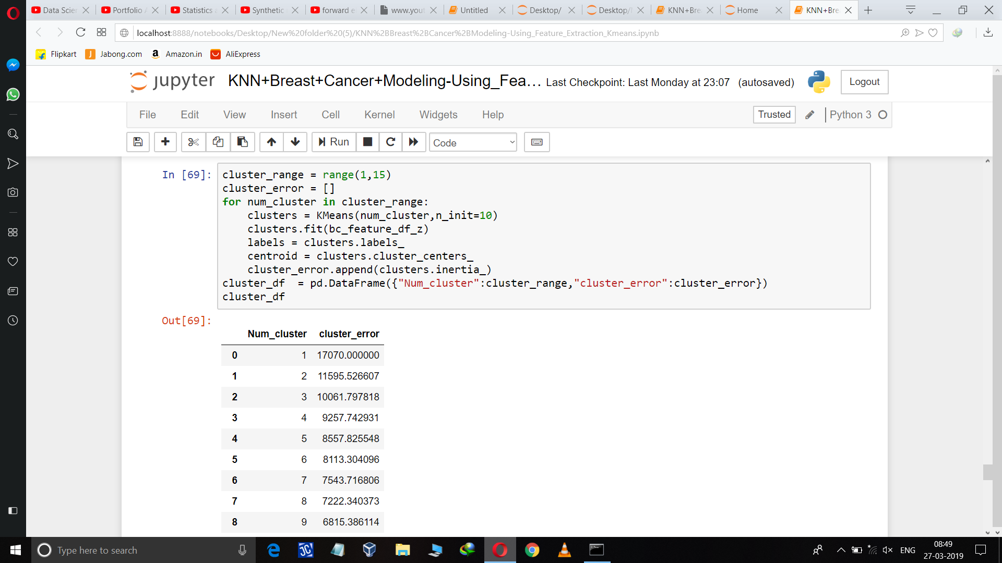
As we are getting a moderate increase in the accuracy we are decreasing the variance error by using PCA.
So, using K-means which is a unsupervised technique which helps to check the importance of particular independent variables in predicting the dependent variables .

Slide 14
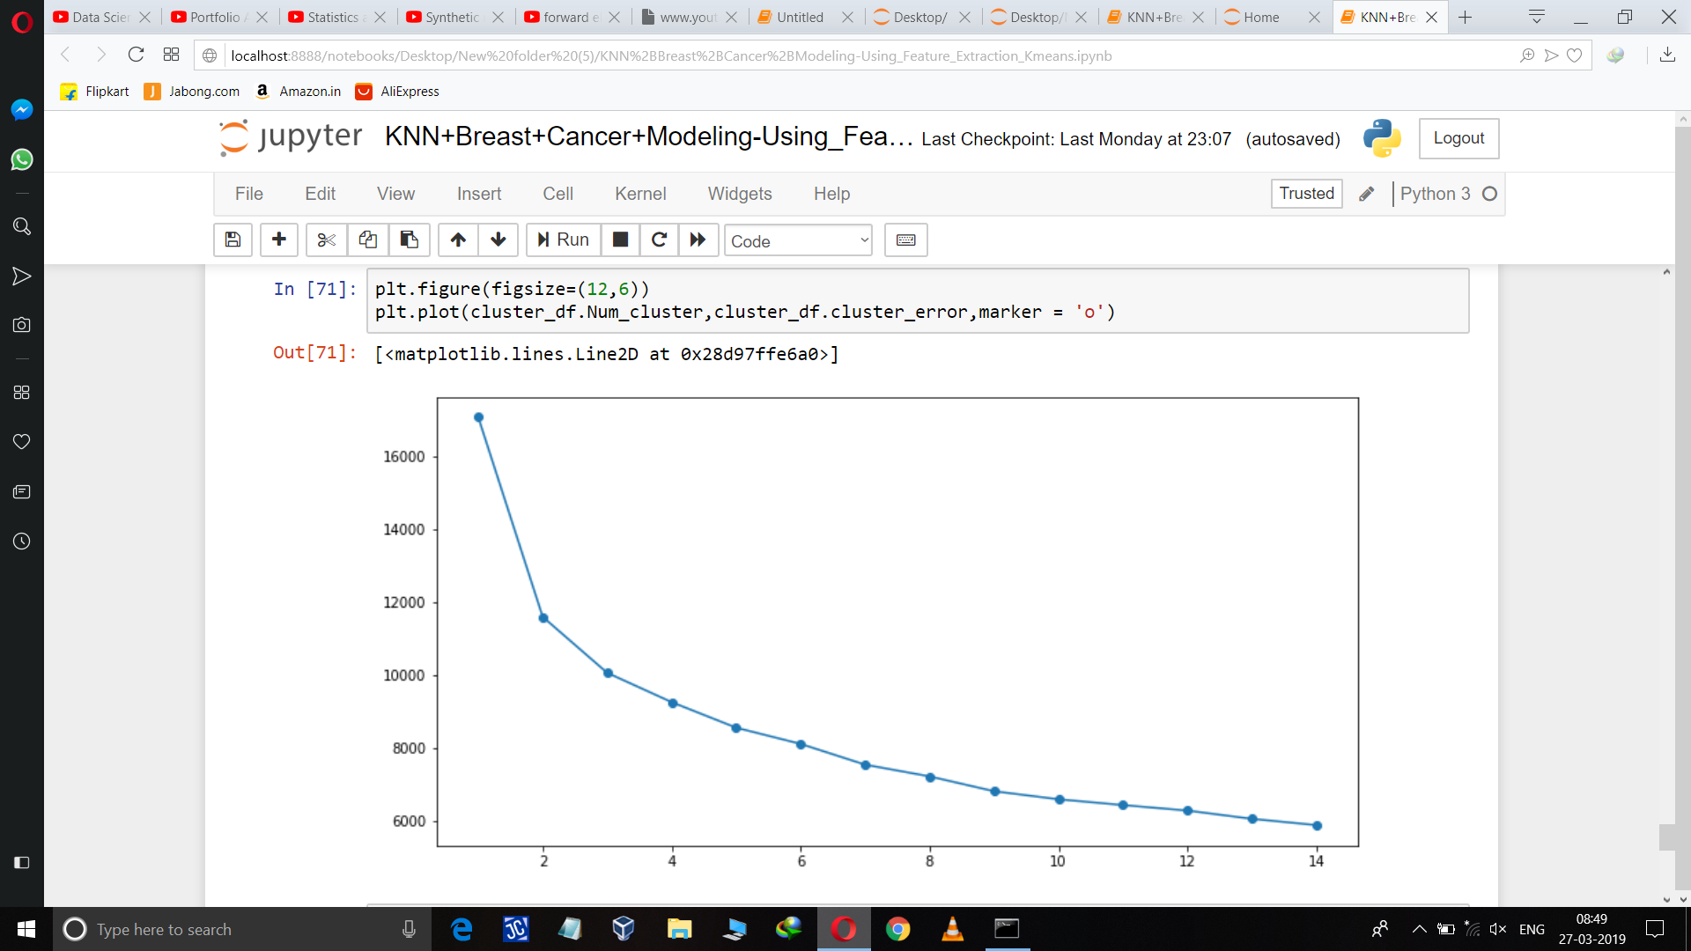
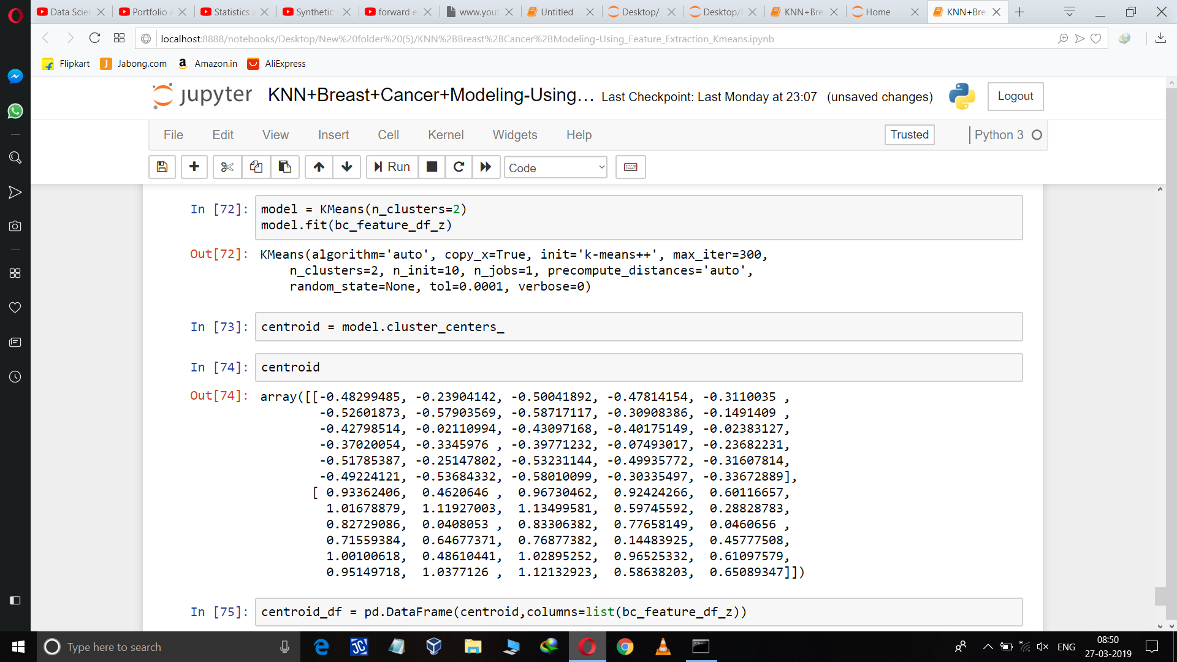
Elbow Plot : to judge cluster values visually
Cluster =2

Slide 15
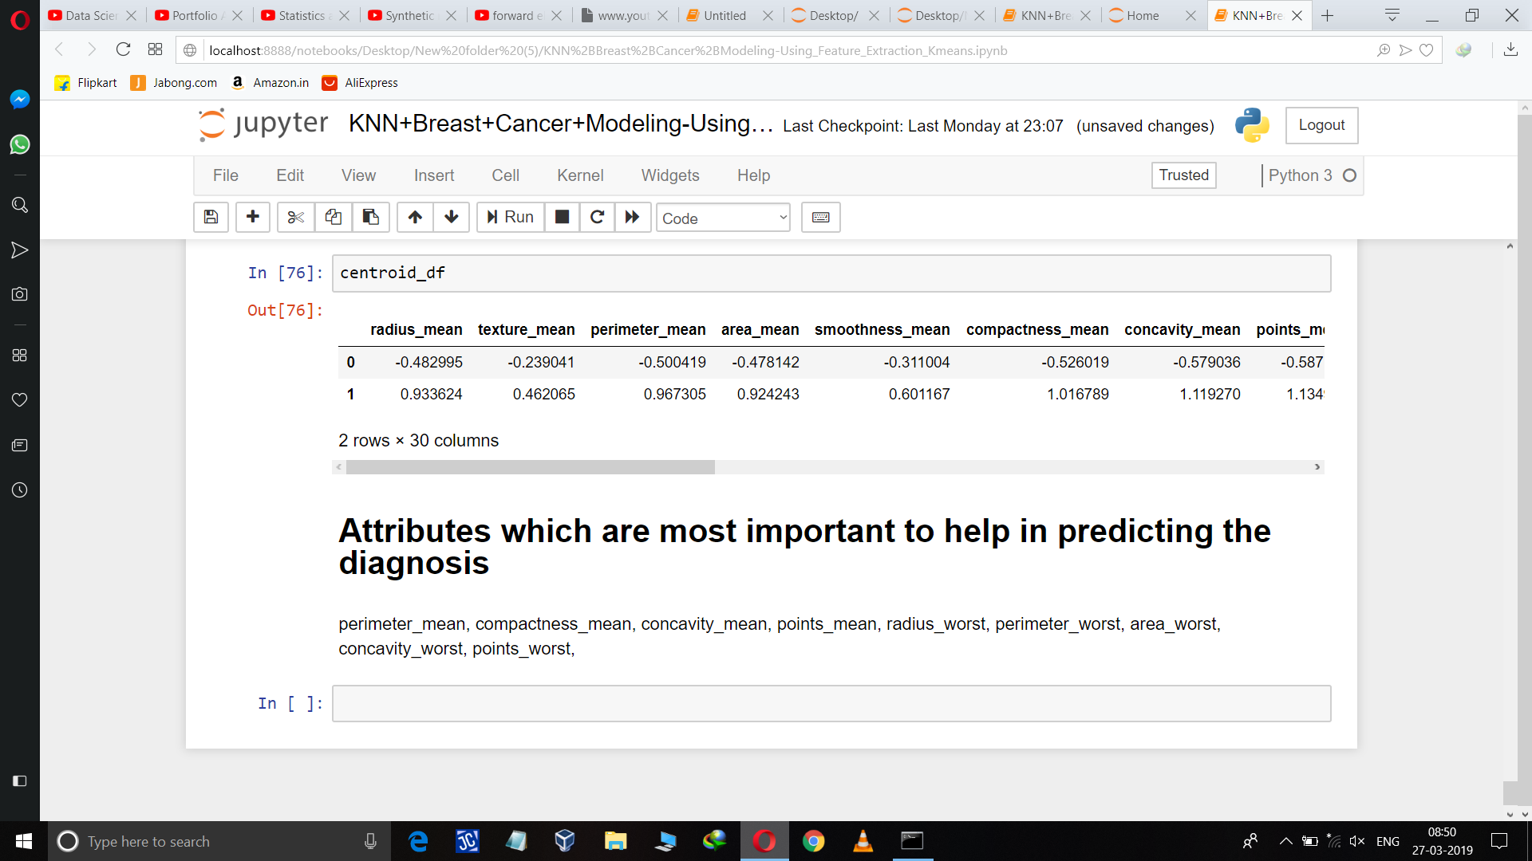

Slide 16
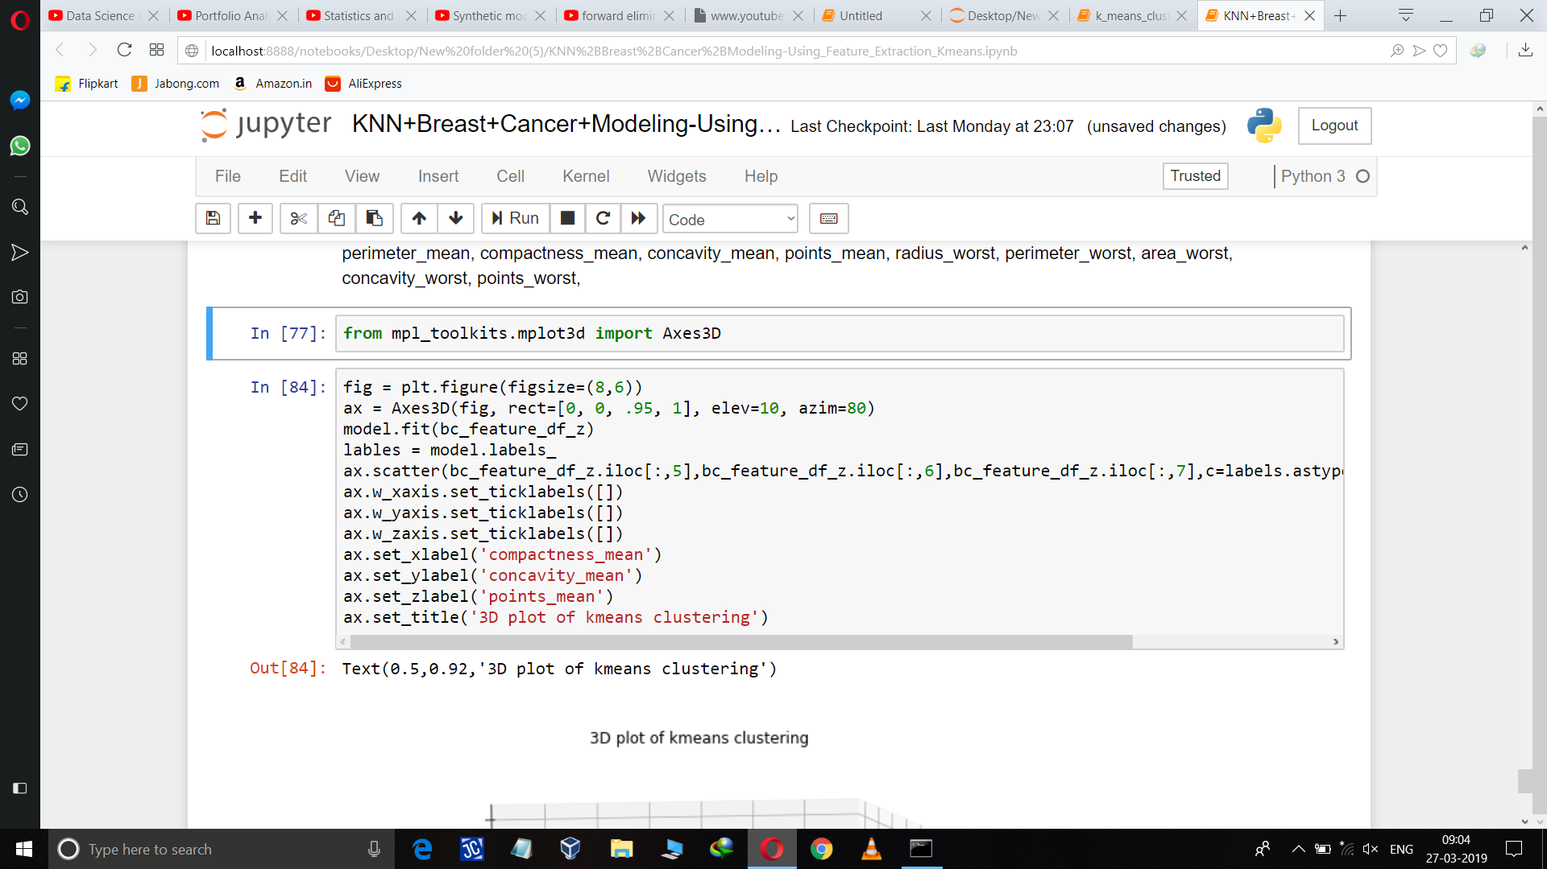
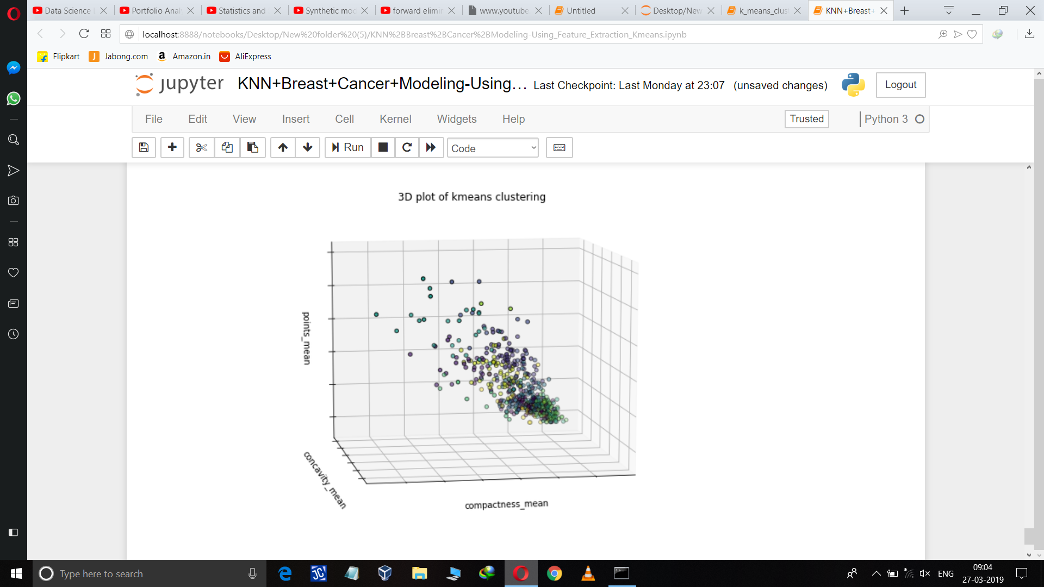
Plotting important feature graph :

Slide 17
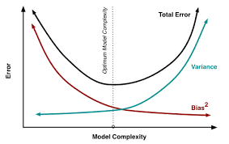
Variance and Bias Error Curve

Slide 18
Thank you

